Slide 1

NYUAD Dining Central
Notes:
Today We will be talking about Charles and Ray Eames
Eames were a collaborative duo of American architects and designers known for their groundbreaking furniture and houses

Slide 2

What is the problem?
Notes:
Do you ever feel like ur in such a rush and you dont feel like wasting time at d2 cuz u have to roam around and look for what u want
did u ever feel like ordering from somewhere else after going through all the counters and leaving disappointed?
Have u ever wondered what in the world those symbole on the nutritional tags mean? and u really wanna know because u wanna track ur calories and wanna put on some mass if ur like me? xD
Have u ever been in a situation where youve run out of mealswipes by the start of wwekend and then u realise you dont have any campus dirhams

Slide 3
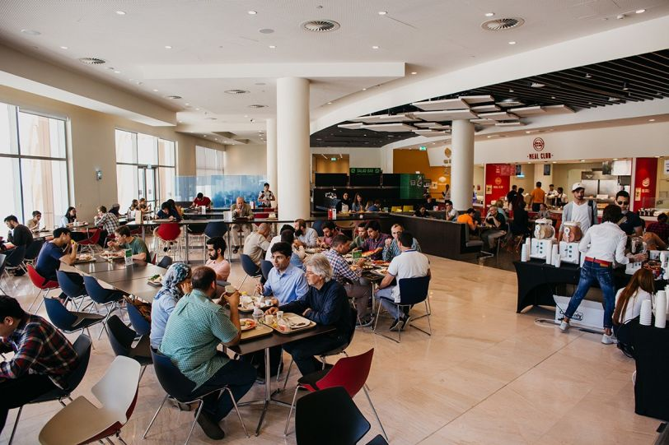
The Problems: Accessibility of Menu and Nutritional Values
Accessibility of nutritional facts
Time wastage
Waiting for food if it’s being replenished
Hard for visitors to find meals according to their tastes
NYUAD East Dining Hall
Notes:
Apart from all the situations that we’ve been in we also realised that we are facing the problem
lack of easy access to the information about the the nutritional facts of every dish/meal available at the counters .
time wastage as people look through the food options each counter offers.

Slide 4
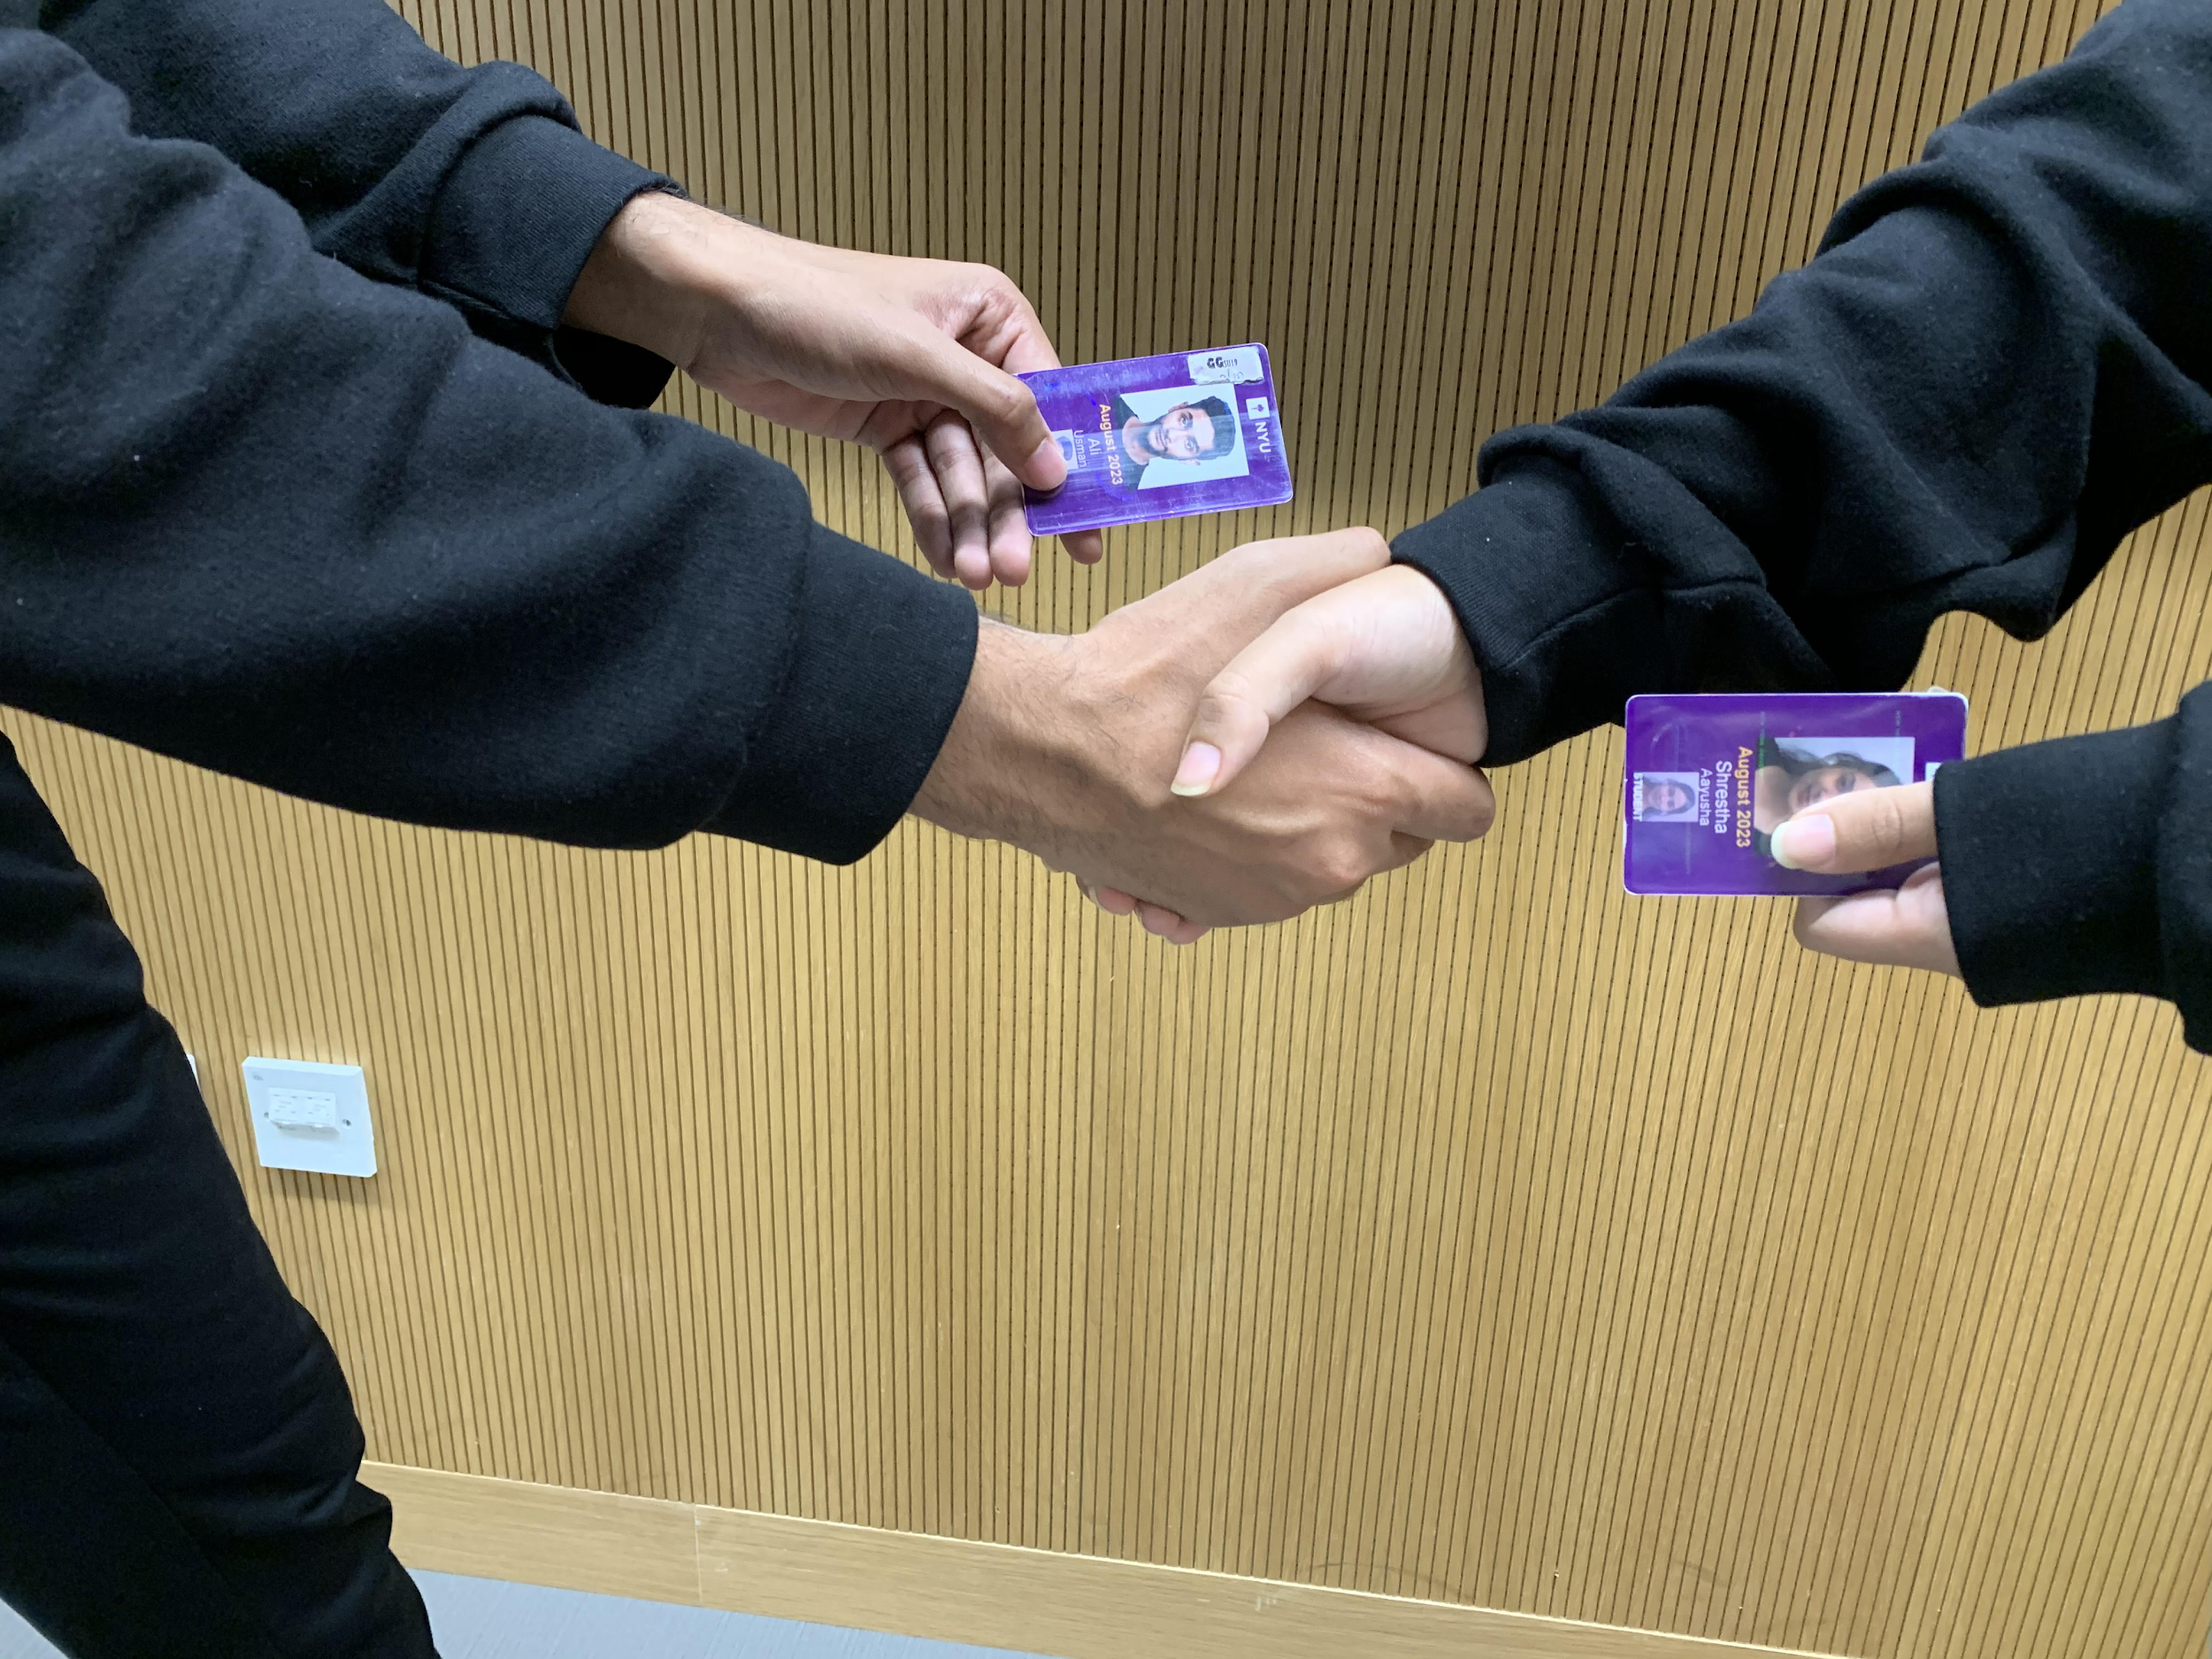
The Problems : Mealswipe Share
Students running out of meal swipes during the weekend
Budget management struggles (Campus dirhams + meal swipes)
Struggling to social and meet new people
NYUAD Students sharing meal swipe
Notes:
U would’ve noticed the posts on ROR about this persistent problem

Slide 5

How do we tackle this issue?

Slide 6
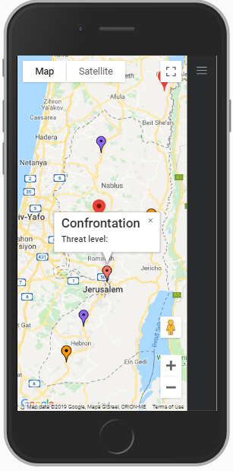

Solution
A product for NYUAD students that enables them to access a wide variety of information regarding food availability, nutrition, allergies and meal swipe sharing.

Slide 7



Ingredients

Slide 8

Demo time

Slide 9
What are the next steps?

Slide 10
The Next Steps
Connecting to a server to send real time updates
Coordinating with ADNH to:
Accurately feature menu items and information (nutrition, price, etc.)
Display availability of counters and food items
Implementing a messaging function within the app
Live time updates to meal swipe availability
Checking balance of meal swipes and campus dirhams

Slide 11
Going Beyond
Expanding beyond D2 to include other food choices on campus:
Marketplace
Sushi Counter
Beyond New York Pizza
Implement delivery service through our app
Calorie/Nutrition Tracker

Slide 12
QUESTIONS?

